Slide 1
An algorithm with linear expected running time for string editing with substitutions and substring reversals
Abdullah N. Arslan
Information Processing Letters 106 (2008) 213–218
Speaker: Chun-Jen Chen
Date: Dec. 29, 2008

Slide 2
Abstract
The edit distance between given two strings X and Y is the minimum number of edit operations that transform X into Y without performing multiple operations that involve the same position. Ordinarily, string editing is based on character insert, delete, and substitute operations. Motivated from the facts that substring reversals are observed in genomic sequences, and it is not always possible to transform a given sequence X into a given sequence Y by reversals alone (e.g., X is all 0’s, and Y is all 1’s), Muthukrishnan and Sahinalp
115/11/07

Slide 3
Abstract
[S. Muthukrishnan, S.C. Sahinalp, Approximate nearest neighbors and sequence comparison with block operations, in: Proc. ACM Symposium on Theory of Computing (STOC), 2000, pp. 416–424; S. Muthukrishnan, S.C. Sahinalp, An improved algorithm for sequence comparison with block reversals, Theoretical Computer Science 321 (1) (2004) 95–101] considered a “simple” well-defined edit distance model in which the edit operations are: replace a character, and reverse and replace a substring. A substring of X can only be reversed if the reversal results in a match in the same position in Y. The cost of each character replacement and substring reversal is 1.
115/11/07

Slide 4
Abstract
The distance in this case is defined only when |X| = |Y| = n. There is an algorithm for computing the distance in this model with worst-case time complexity O(n log² n) [S.Muthukrishnan, S.C. Sahinalp, An improved algorithm for sequence comparison with block reversals, Theoretical Computer Science 321 (1) (2004) 95–101]. We present a dynamic programming algorithm with worst-case time complexity O(n²) but its expected running-time is O(n). In our dynamic programming solution the weights of edit operations can vary for different substitutions, and the costs of reversals can be a function of the reversal-length.
115/11/07

Slide 5
Edit Distance
X= accaagagcg
Y= aggaacacgc
5 replace operations.

Slide 6
Edit Distance
X= accaagagcg
Y= aggaacacgc
2 replace and 2 reverse operations.

Slide 7
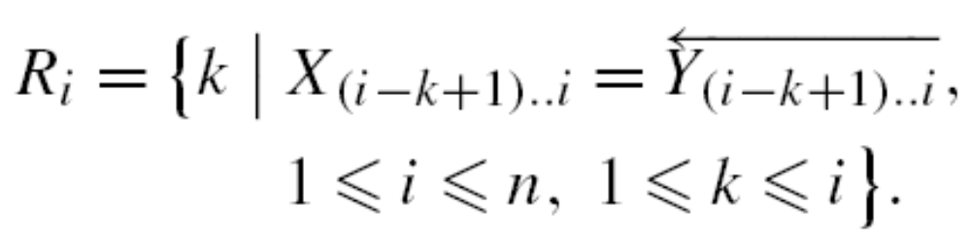
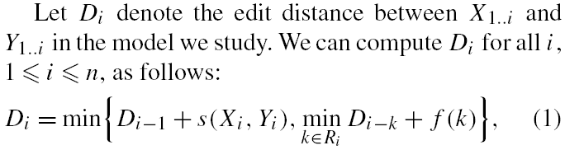
Dynamic Programming
Time: O(n + |R|)

Slide 8
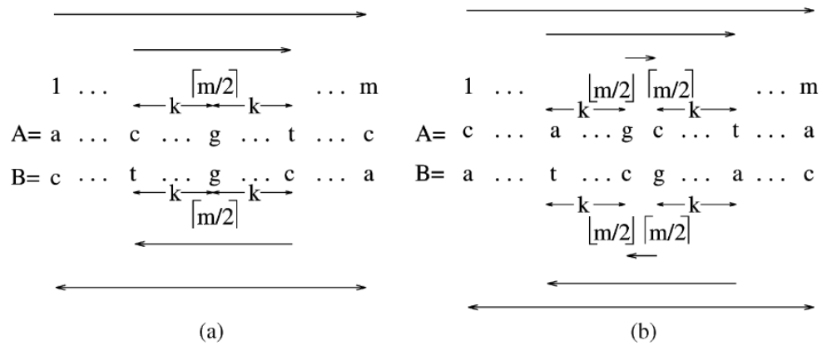

Slide 9
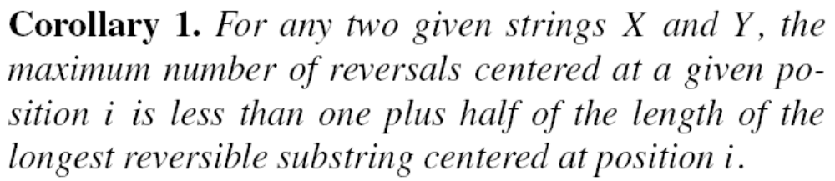

Slide 10

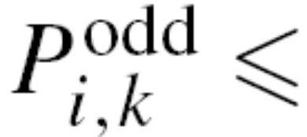
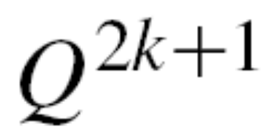
Let S be a randomly chosen string, and i be any position in S. Let Q_{s} be the probability that symbol s appears in position i in S, and Q be the maximum Q_{s} over all s ∈ Σ.

Slide 11
